Slide 1
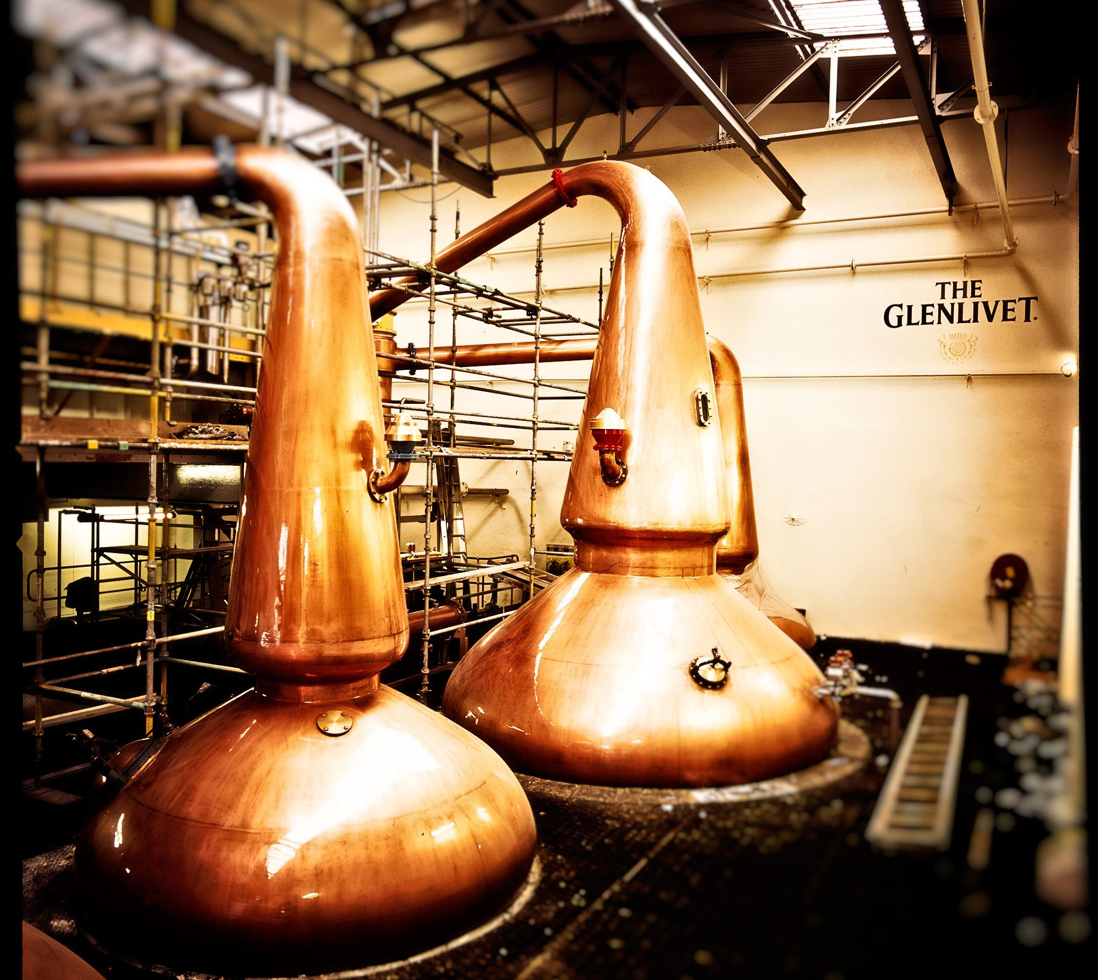
Thermodynamics of An Alcohol Distillation Process with specific focus on Scotch Whiskey
Max Milarvie
Whiskey

Slide 2
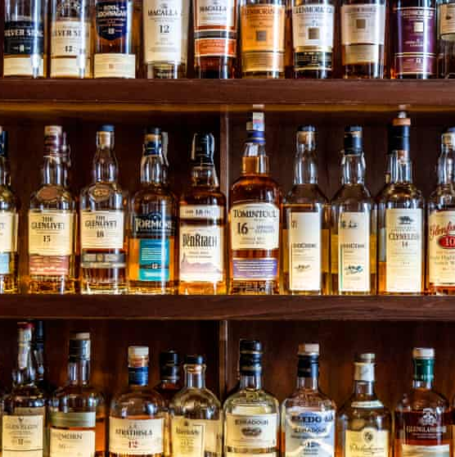
Scotch Whiskey
Earliest reference in literature in 1494 in the Scottish Exchequer Rolls, and is protected by Geographical Indication (GI) status [1]
Contributed 2 billion USD to the British economy in 2019 directly, with Gross Value Added of 6.5 billion USD
In Scotland alone there are 160 whiskey distilleries across 5 major production regions. [2,3]
About

Slide 3
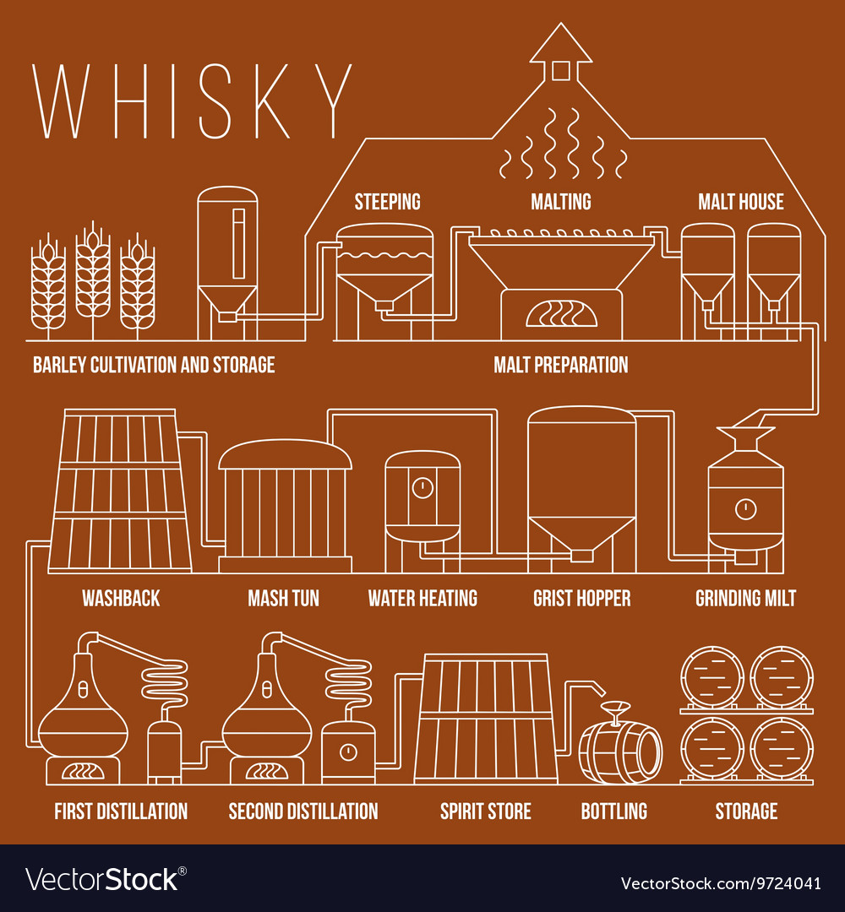
Process overview
Malting
Milling
Germination of barley to release starches for fermentation, then drying
Grinding of barley into a fine powder
Mashing
Fermentation
Heating of the milled barley with hot water, using enzymes to convert starch to sugar
Converting of sugars into alcohol using S. cerevisiae yeast
Distillation
Maturation
Unit operation process which allows the increase in alcohol concentration
Aging of distilled whiskey in wooden barrels [4].
Image credit: https://www.vectorstock.com/royalty-free-vector/whiskey-production-process-infographic-vector-9724041

Slide 4
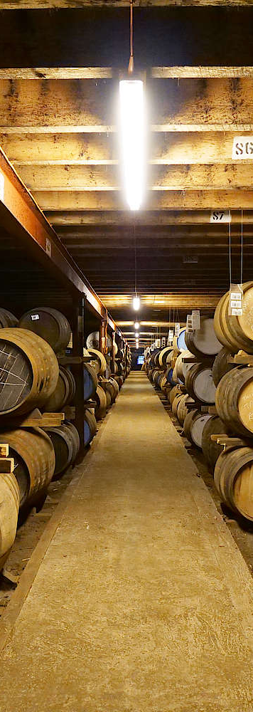
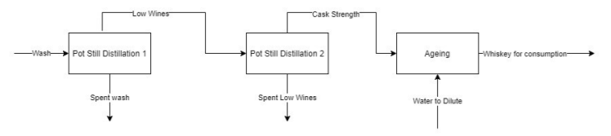
Duty Requirements of the process
 | Operation | Volumetric Flow [m³/hr⁻¹] | Stream Capacity [kw/k] | Duty [kw]
Wash | Heating | 318.9 | 354.6 | 21273.7​
Spent Wash​ | Cooling | 22.3 | 25.5 | 1532.9​
Low Wines | Heating | 86.7 | 87.6 | 5257.5​
Low Wines | Cooling |  |  | 5257.5​
Spent Low Wines | Cooling | 22.1 | 25.3 | 1517.6​
Cask Strength | ​Cooling | ​31.3 | ​24 | 1441.6​
Whiskey for consumption | ​ | ​43.8 | 38.4 | ​
Total Heating duty |  |  |  | 26531.3
Total Cooling duty |  |  |  | 9749.6

Slide 5
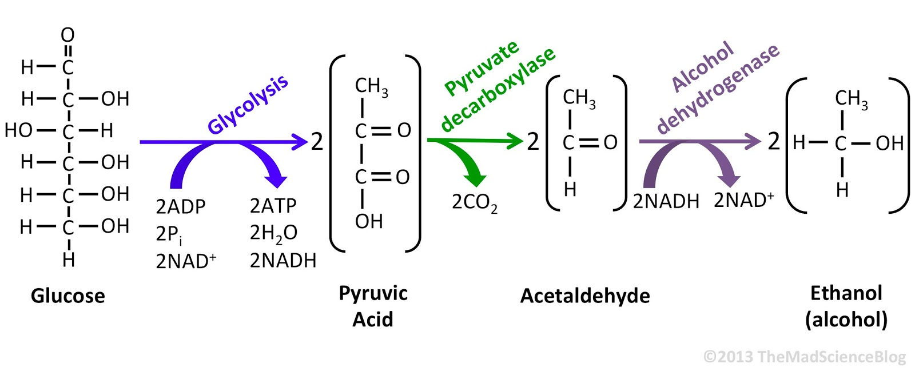
Fermentation
$C_{6}H_{12}O_{6}\underset{→}{Yeast}{2C}_{2}H_{6}OH$ $+2CO_{2}, {∆G}_{Rxn}^{0}=−218\frac{kJ}{mol Glucose}$
At 25°C, K = 10³⁷
Yeast is 93% efficient for conversion of glucose to alcohol thus reaction quotient, Q = 43
Glucose is almost fully consumed during the reaction
Reaction selectivity to produce side products from use of S. Cerevisiae including pyruvate, succinate and acetate.

Slide 6
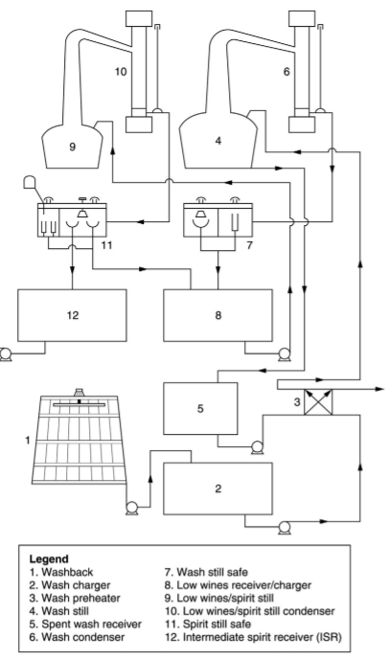
Novel Technology and applications
Heat Pumps
Ultra Low-grade heat
Anaerobic digestion
Inherent cooling requirement involved in process thus utilization of ‘waste heat’ is a major focus of the industry currently
Wider usage of heat integration systems including complex heat exchanger networks
Systems implemented with focus on improvement of local communities
Allows for the usage of ‘waste’ reactants after utilization, like grist after the mash-ton.
Can convert such waste into biogas for usage internally or for the local community
Image credit: Denis Arthur Nicol. (2003). Batch Distillation. In Whisky: Technology, Production and Marketing (pp. 153–176).

Slide 7
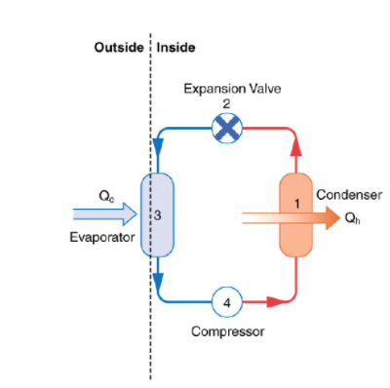
Heat Pumps
Like a refrigeration cycle but with the heat absorbed by the refrigerant being captured and utilised
A compressor increases the temperature of a source of heat and the work performed to the compressor is of reasonable cost to increase the temperature of the fluid for utilisation elsewhere
Greater utilisation of low temperature waste water using open-loop water source heat pumps, which utilises a refrigerant to transfer heat from water for use in other applications, by utilising the water to vaporise a liquid refrigerant, which is then compressed to increase its temperature and condensed over a heat exchanger.
Current coefficients of performance are in the region of 4-6 and are being implemented
across Scotland such as in the River Clyde in Glasgow
Image Credit: Applications of Thermodynamics- Heat Pumps and Refrigerators. (2021, July 11). OpenStax CNX. https://phys.libretexts.org/@go/page/1598

Slide 8
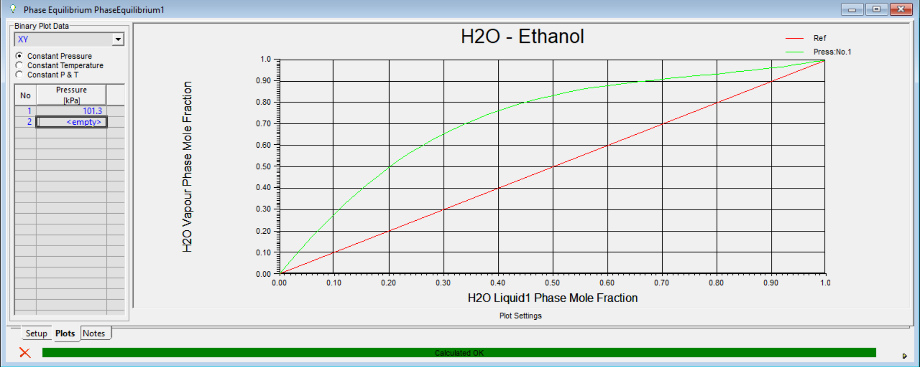
Two Phase Behavior of whiskey
Constant pressure
Fluid package selection:
UNIQUAC – suitable for polar, non-electrolyte solutions at atmospheric pressures
System approximated as 60%mass water, 40%mass ethanol, or 79.3%mol water, 20.7%mol ethanol.
X_{water} vs Y_{water} at constant pressure of 1 atm

Slide 9
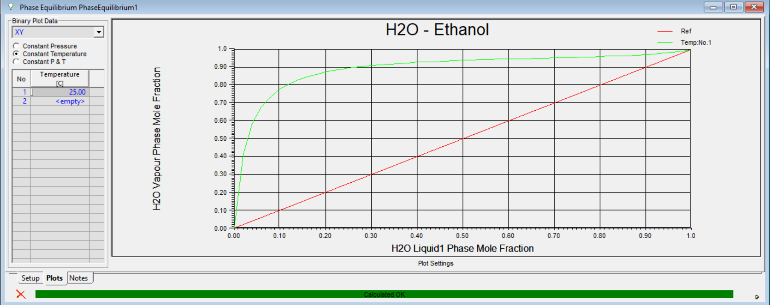
Two Phase Behavior of whiskey
Constant temperature
Fluid package selection:
UNIQUAC – suitable for polar, non-electrolyte solutions at atmospheric pressures
System approximated as 60% water, 40% ethanol.
X_{water} vs Y_{water} at constant temperature of 25°C.

Slide 10
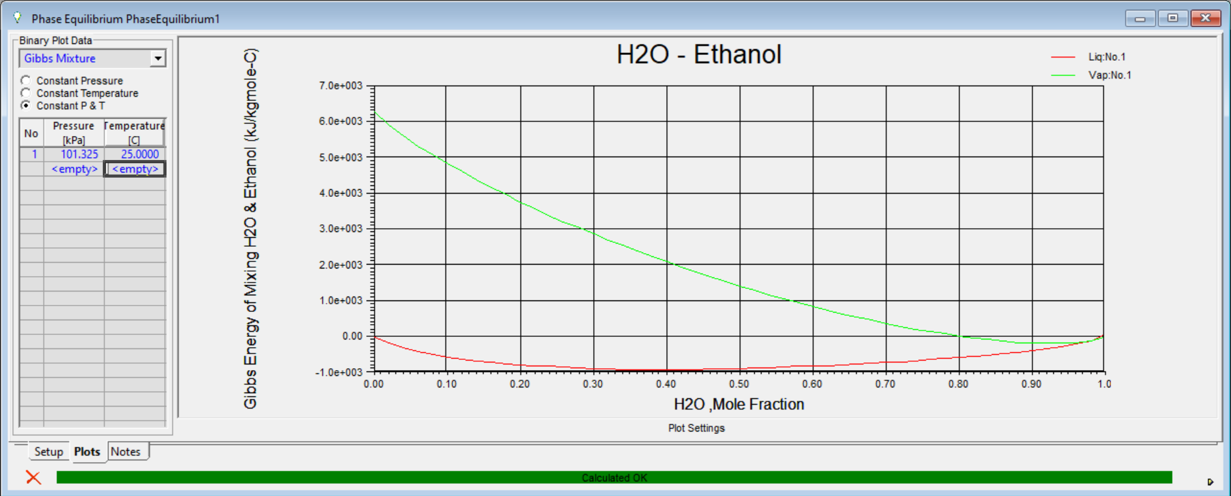
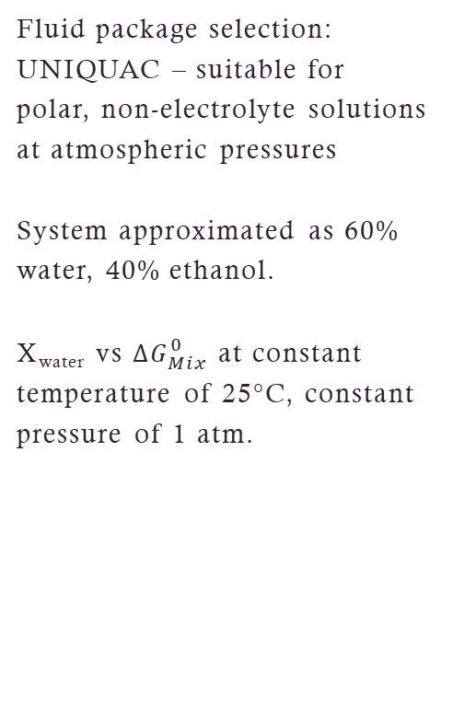
Two Phase Behavior of whiskey
Gibbs energy of mixing
Fluid package selection:
UNIQUAC – suitable for polar, non-electrolyte solutions at atmospheric pressures
System approximated as 60% water, 40% ethanol.
X_{water} vs ${∆G}_{Mix}^{0}$ at constant temperature of 25°C, constant pressure of 1 atm.

Slide 11
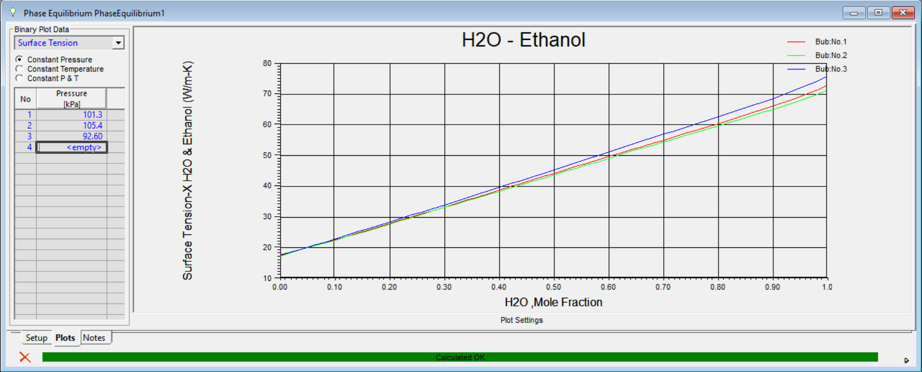
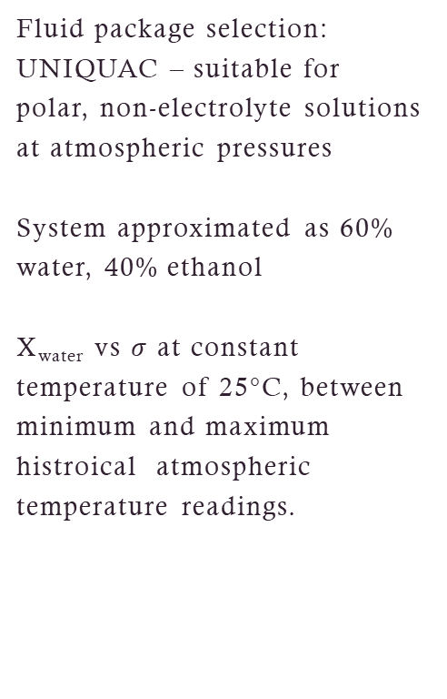
Two Phase Behavior of whiskey
Surface tension
Fluid package selection:
UNIQUAC – suitable for polar, non-electrolyte solutions at atmospheric pressures
System approximated as 60% water, 40% ethanol
X_{water} vs $σ$ at constant temperature of 25°C, between minimum and maximum histroical atmospheric temperature readings.

Slide 12
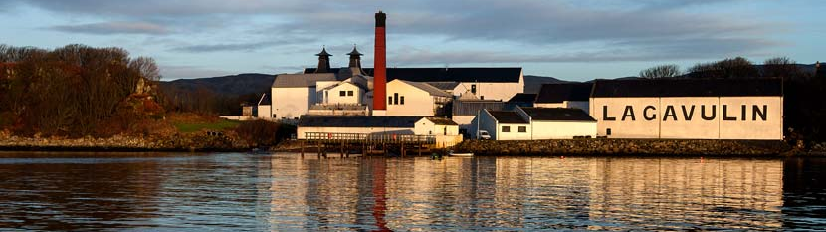
Thanks for listening
Thanks
I am happy to answer any questions now or to have a conversation after this class

Slide 13
References
[1] Value of whisky exports from the United Kingdom in 2019, by trading region. (2019). HM Revenue and Customs. https://www.statista.com/statistics/305127/uk-unitedkingdom-whisky-export-value-by-continent/.
[2] The Economic Impact of Scotch Whisky production in the UK. (2016). Scottish Whisky Association. https://www.statista.com/statistics/690832/employment-economicimpact-of-scotch-whisky-in-the-united-kingdom/
[3] Whisky Invest Direct. (2019). Malt whisky distilleries in Scotland. https://www.whiskyinvestdirect.com/about-whisky/malt-whisky-distilleries-in-scotland
[4] Simon Difford. (2021). Single Malt Scotch Whisky Production. Difford’s Guide. https://www.diffordsguide.com/g/1168/single-malt-scotch-whisky-production

